Slide 1
Introducing Web Workers

Slide 2
Objectives
In this session, you will learn to:
  Use Web Workers in Web Pages

Slide 3
Using Web Workers in Web Pages
Consider a scenario of a Web page that displays tweets of famous personalities and also allows users to submit their tweets.
The Web page uses JavaScript to fetch the tweets of famous personalities, along with the date and time the tweets were posted.
Whenever a user accesses the page, the user needs to wait until the page retrieves and displays the tweets before the user can submit his/her tweet.
In this scenario, the ideal solution will be to enable a user to submit a tweet on accessing the page instead of making him/her wait till the page fetches and displays the tweets of famous personalities.
You can implement the solution by using Web workers.

Slide 4
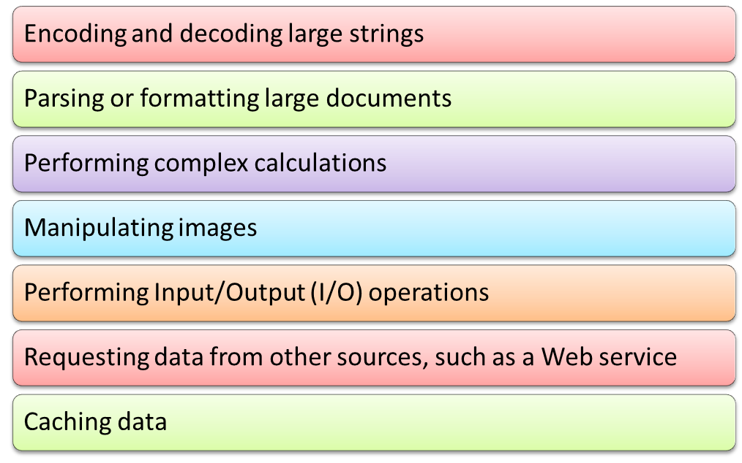
Understanding the Basics of Web Workers
Web workers are background scripts executed using isolated threads that run independently of other scripts, without affecting the performance of a Web page.
Web workers run on separate threads and are resource-intensive for the browser as the browser needs to create and manage multiple threads.
Some of the scenarios for using Web workers are:

Slide 5
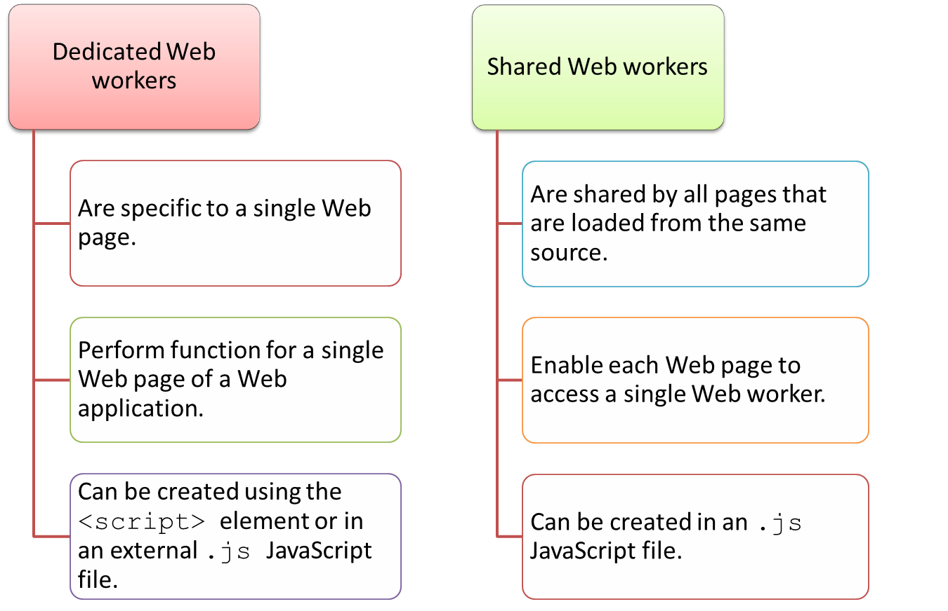
Understanding the Basics of Web Workers (Contd.)
Web workers can be categorized into:

Slide 6
Creating Web Workers
Before creating Web workers, you should check whether the client browser supports Web workers.
The following code snippet shows how to check whether a browser supports Web workers:
function Test()
{
if(typeof(Worker) !== "undefined")
{
alert("Web browser supports Web workers");
} else {
alert("Sorry !!! Your Web browser does not support Web workers");
}
}

Slide 7
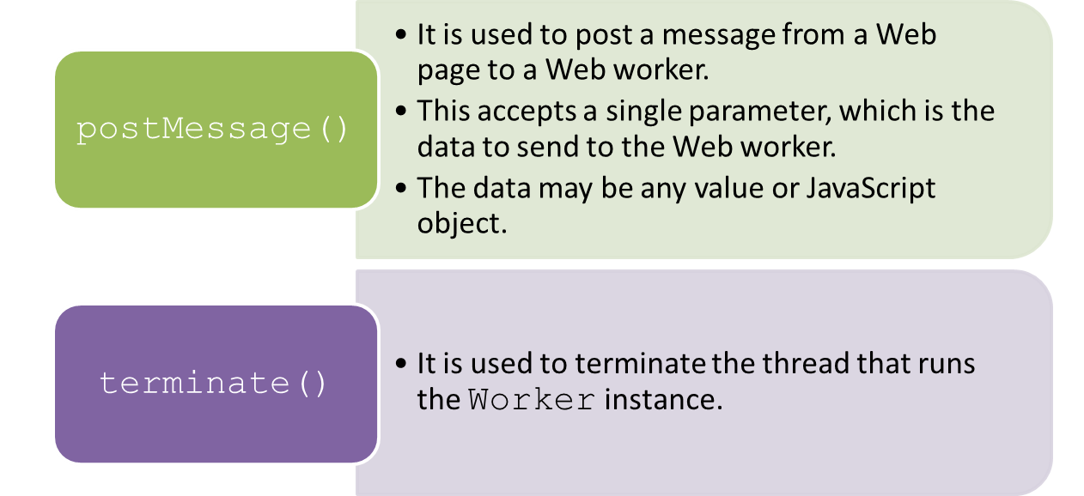
Creating Web Workers (Contd.)
A dedicated Web worker is created by creating an instance of the Worker object and passing the URI of the JavaScript file to execute the Worker constructor, as shown in the following code snippet:
To interact with the Worker instance, you need to call the following methods:
var testWorker = new Worker('workerscript.js');

Slide 8
Creating Web Workers (Contd.)
The following code snippet depicts the contents of the HTML file for the Web page that invokes the Web worker:
…
<body>
Enter your Name :<input type="text" id="Ename" size="15">
<input type="button" value="Send" onclick="WebWorkerDemo()">
<script>
function WebWorkerDemo() {
var name = document.getElementById("Ename").value;
worker_obj = new Worker("Web_Worker.js");
worker_obj.postMessage(name);
worker_obj.onmessage = function (event) {
document.getElementById("result").innerHTML += event.data;
};
}
</script>
<p> <output id="result"></output></p>
</body>
…

Slide 9
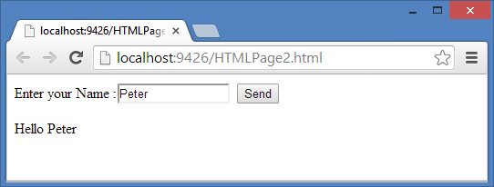
Creating Web Workers (Contd.)
The Web_Worker.js file contains the following code:
The output of the preceding code snippet is shown in the following figure.
self.onmessage = function(e)
{
self.postMessage("Hello"+ " " + e.data);
};

Slide 10
Creating Web Workers (Contd.)
A shared Web worker is created by creating an instance of the SharedWorker object and passing the URI of the script file to execute to the constructor of the SharedWorker instance, as shown in the following code snippet:
The following code snippet shows the code to use shared Web worker in a Web page:
var testSharedWorker = new SharedWorker('sharedWorker1.js');
…
<script>
var worker = new SharedWorker('SharedWebWorker.js');
worker.port.addEventListener("message", function(e) {
document.getElementById('result').innerHTML += e.data;
}, false);
worker.port.start();
worker.port.postMessage("Page1");
</script>
…

Slide 11
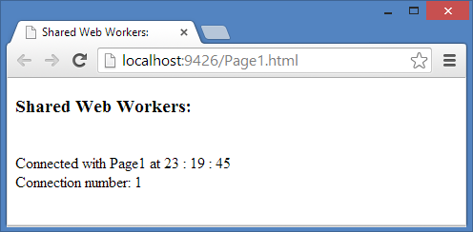
Creating Web Workers (Contd.)
The SharedWebWorker.js file contains the following code:
The output of the preceding code snippet is shown in the following figure.
…
var connections = 0;
self.addEventListener("connect", function (e) {
var port = e.ports[0];
connections++;
var strTime = getTime();
port.addEventListener("message", function (e) {
port.postMessage("Connected with " + e.data + " at " + strTime +"<br/> Connection number: " + connections);
}, false);
port.start();}, false);
…

Slide 12
Handling Errors
When a Web worker executes, JavaScript runtime errors might occur.
When an error occurs, the onerror event is triggered.
In the event handler of the onerror event, you can retrieve and display the JavaScript file name, the line number where the error occurred, and the error message.
The following code snippet shows how to handle errors in a Web worker:
testworker.onerror = function(e)
{
document.getElementById('errormessage').textContent =[ e.filename, e.lineno, e.message]};

Slide 13
Loading Scripts
Sometimes, you may need to load multiple script files or libraries into a Web worker.
For this, you can use the importScripts() global function.
When you create multiple Web workers in an application that requires document compression, you can reuse the script file instead of rewriting the document compression code in each of the Web worker files.
The importScripts() function accepts the name of the resource to load as a string, as shown in the following code snippet:
You can also pass multiple resources that you want to load to the importScripts() method.
importScripts('externalscript1.js');
importScripts('externalscript2.js');

Slide 14
Loading Scripts (Contd.)
The following code snippet displays how to import a script file in a Web worker:
var connections = 0; // count active connections
self.addEventListener("connect", function (e) {
var port = e.ports[0];
connections++;
var strTime = getTime();
port.addEventListener("message", function (e) {
port.postMessage("Connected with " + e.data + " at " + strTime +"<br/> Connection number: " + connections);
}, false);
port.start();
}, false);
importScripts('DateTimeFile.js');

Slide 15
Loading Scripts (Contd.)
In the preceding code snippet, the importScripts() function is used to import the JavaScript file named, DateTimeFile.js that contains the following code snippet:
function getTime() {
var today = new Date();
var h = today.getHours();
var m = today.getMinutes();
var s = today.getSeconds();
m = checkTime(m);
s = checkTime(s);
return(h + " : " + m + " : " + s);
}
function checkTime(i) {
if (i < 10) { i = "0" + i }; // add zero in front of numbers < 10
return i;
}

Slide 16
Just a Minute
Which one of the following Web workers are specific to a single Web page?
  Dedicated Web workers
  Shared Web workers

Slide 17
Just a Minute (Contd.)
Answer:
  Dedicated Web workers

Slide 18
Activity: Creating a Quiz Page Using Web Workers
You are working for Tech Vision, an emerging IT company that deals in website development. You have been assigned a task to create a Web page that conducts an online quiz for the forms of the words, who and whoever. You need to use a dedicated Web worker that will compute the quiz time on the background of the Web page while students are giving the quiz test.
The quiz page should be based on the following guidelines:
  Timer should be displayed on top right corner of the Web page.
  Total score should be displayed on the submission of test.
  Check whether a client browser supports Web workers.
Prerequisite: To perform this activity, you need the QuizTimer.zip file.

Slide 19
Activity: Creating a Dedicated Web Worker to Perform the Computation on the Background of the Web Page
Earnest Education is a training provider for college and University students. Recently Earnest Education has moved into online training. They have a website that is still under development. You and your team working for Tech Vision, a Web development company, is working on the website. The management of Earnest Education wants a Web page that should allow users to compute the sum of large numbers. During your team meeting, your team has analyzed that the computation will take significant amount of time, and therefore will make the Web page unresponsive during the computation time. You have been assigned a task to provide a solution so that the computation process occurs in a separate thread than the main thread executing the Web page.
You now need to use a dedicated Web worker to perform the computation on the background of the Web page when the Web page loads. You also need to display the progress of the computation process in percentage on the Web page.

Slide 20
Activity: Creating a Dedicated Web Worker to Perform the Computation on the Background of the Web Page (Contd.)
A Web page should be based on the following guidelines:
  Enable a user to enter a number to compute its sum.
  Check whether a client browser supports Web Workers.
  Handle any error that occurs in JavaScript of the Web Worker.
Prerequisite: To perform this activity, you need the ComputeSum.zip file.

Slide 21
Summary
In this session, you learned that:
  Web workers are background scripts executed using isolated threads that run independently of other scripts, without affecting the performance of a Web page.
  Web workers run on separate threads and, therefore, are resource-intensive for the browser as the browser needs to create and manage multiple threads.
  Shared Web workers are shared by all pages that are loaded from the same source.
  You can create a dedicated Web worker by creating an instance of the Worker object and passing the URI of the JavaScript file to execute the Worker constructor.
  You can create a shared Web worker by creating an instance of the SharedWorker object and passing the URI of the script file to execute to the constructor of the SharedWorker instance.
  When an error occurs while the Web worker is being executed, the onerror event is triggered.
  Sometimes, you may need to load multiple script files or libraries into a Web worker. For this, you can use the importScripts() global function.

Slide 22
What’s Next?
After this session, you need to do the following tasks:
  Go through the recorded lectures on the following topics through Cloudscape:
    Introducing Web Workers
    Creating Advance jQuery Mobile Pages
  Perform the following exercises of Chapter 11:
    Exercise 1
    Exercise 2
  Attend Cycle Test 8

